Slide 1
Preliminary Pressure Capsule Results
Using SS316H LAROMANCE material model,
Loading conditions constrained to SS316H model limits

Slide 2
General Assumptions and Model Ranges
Modeling conditions set by application range of the SS316H ROM
Note: SS316H ROM was not developed for this application, but is used as an intermediate step to demonstrate the concepts
Assumed a constant temperature of 801ºC
Assumed initial dislocation densities in range middle:
8.0e12 1/m² mobile dislocation density
7.0e11 1/m² immobile dislocation density
Selected combinations of internal pressure and uniaxial tension to ensure the vonMises Stress remained between 2 – 50 MPa

Slide 3
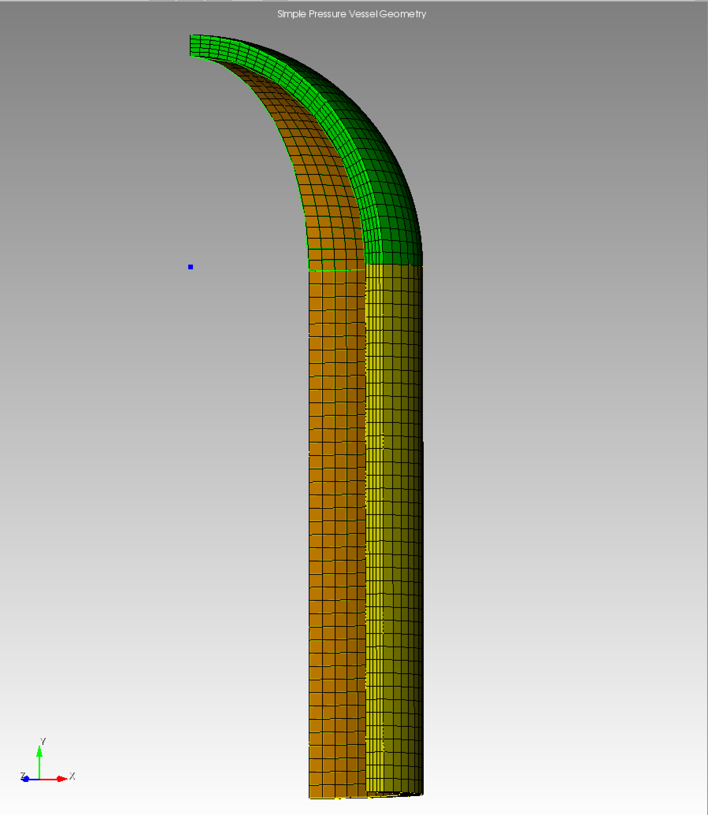
Prolonged Internal Pressure
Varied the internal pressure
Applied to interior of the 1/8 symmetry pressure capsule (shown in orange)
9 Cases: 0.5, 1.0, 1.5, 2.0, 2.5, 3.0, 3.5, 4.0, and 4.5 MPa
All simulations run for 500s with a constant internal pressure
Results are shown for progressively higher internal pressures

Slide 4
General Observations: Constant Pressure
Summation of the results shown in the next 18 slides (2 per case):
Consistent pattern in stresses, strains, and dislocations across the different internal pressure cases
As expected for this high temperature model, we see the higher pressures produce lower dislocation densities
Hoop stress is just a bit larger than von Mises stress in this configuration, so the ranges allowed by the SS316H ROM limited the range to a max hoop stress of 47 MPa
Highlights the importance of working with a ROM designed for the application

Slide 5
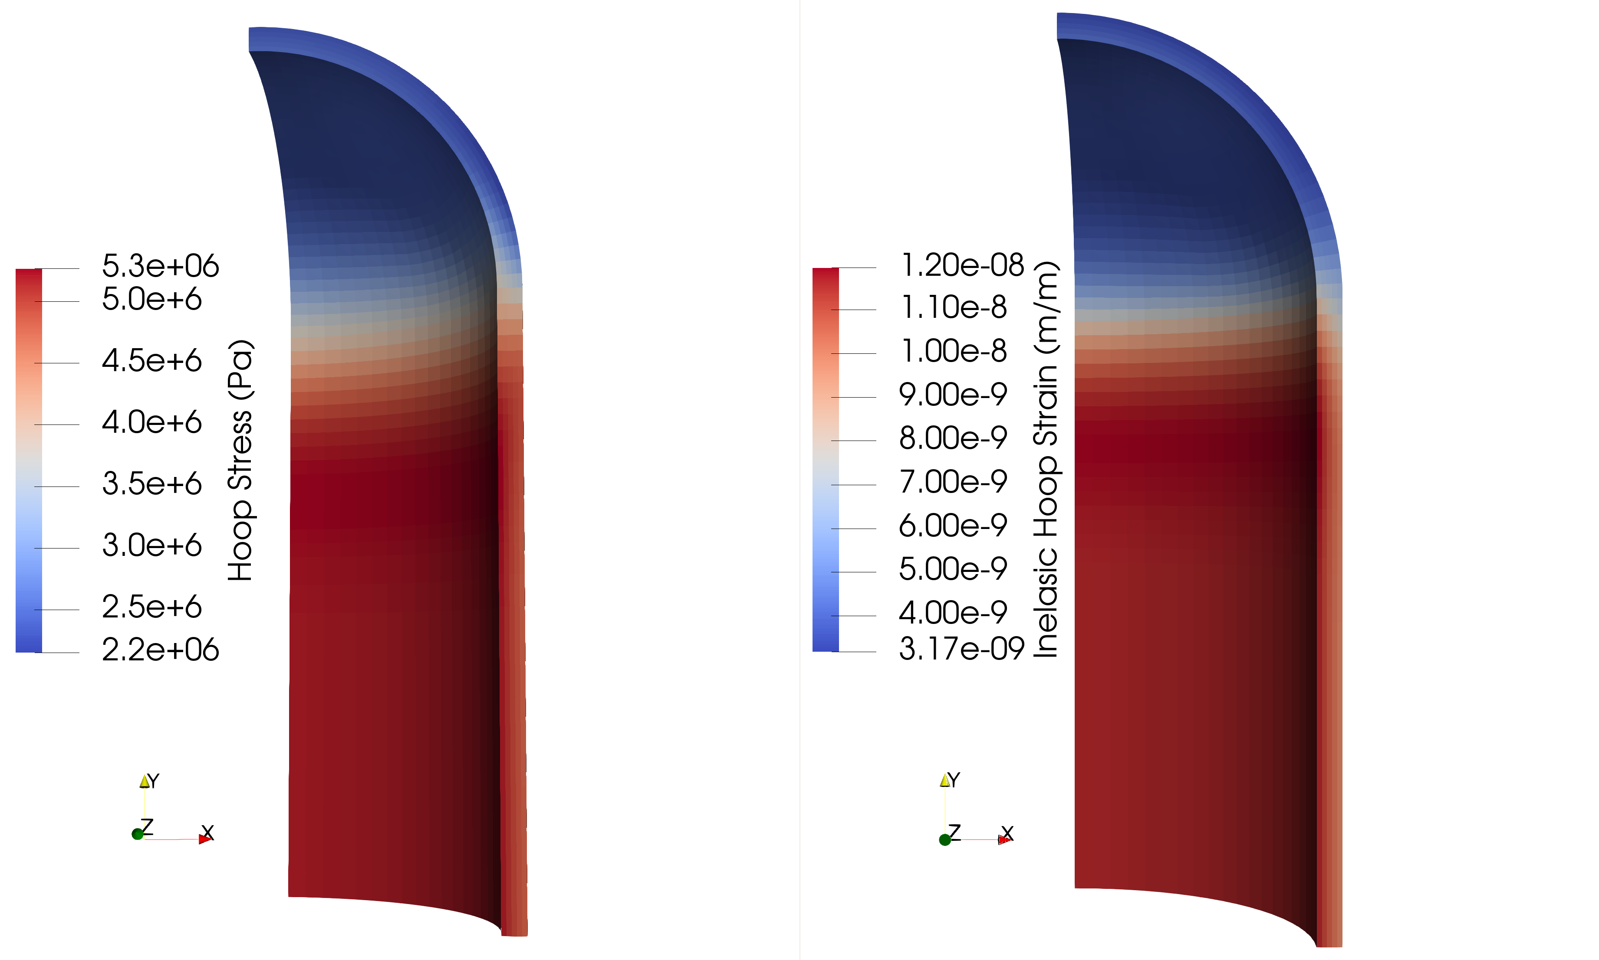
Constant Internal Pressure of 0.5MPa, held for 500s

Slide 6
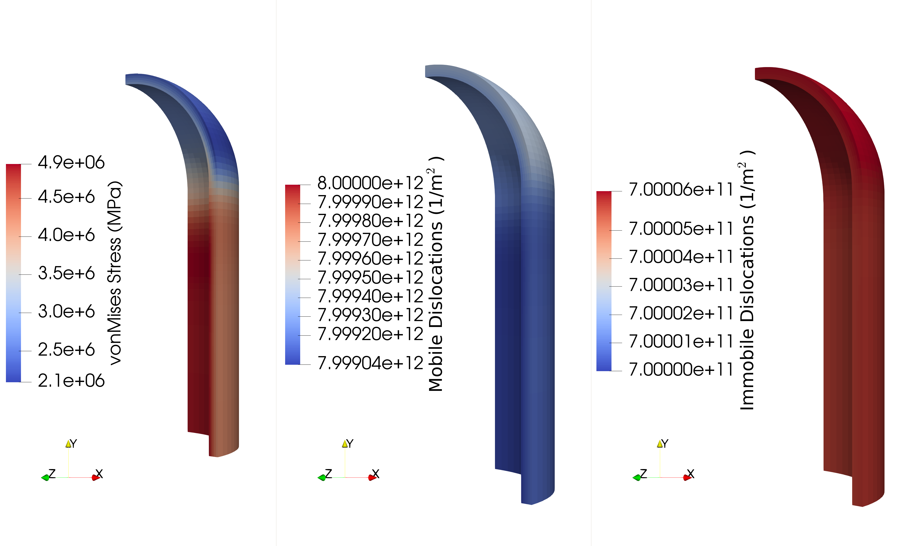
Constant Internal Pressure of 0.5MPa, held for 500s

Slide 7

Constant Internal Pressure of 1.0MPa, held for 500s

Slide 8
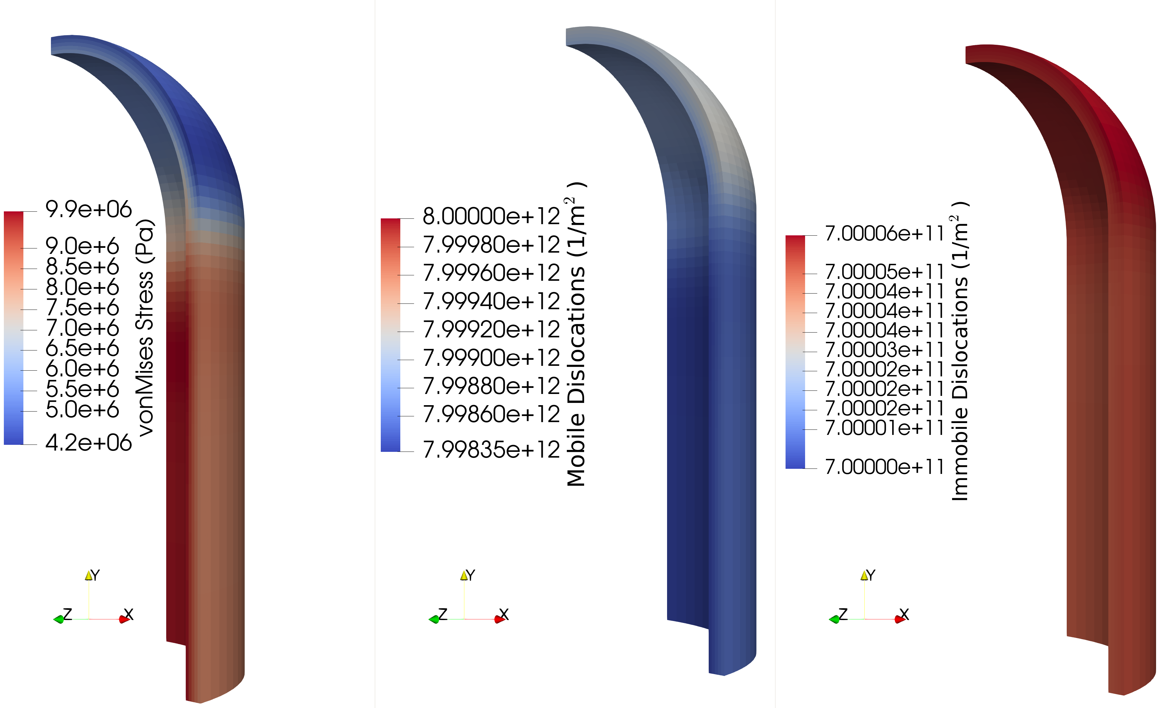
Constant Internal Pressure of 1.0MPa, held for 500s

Slide 9

Constant Internal Pressure of 1.5MPa, held for 500s

Slide 10
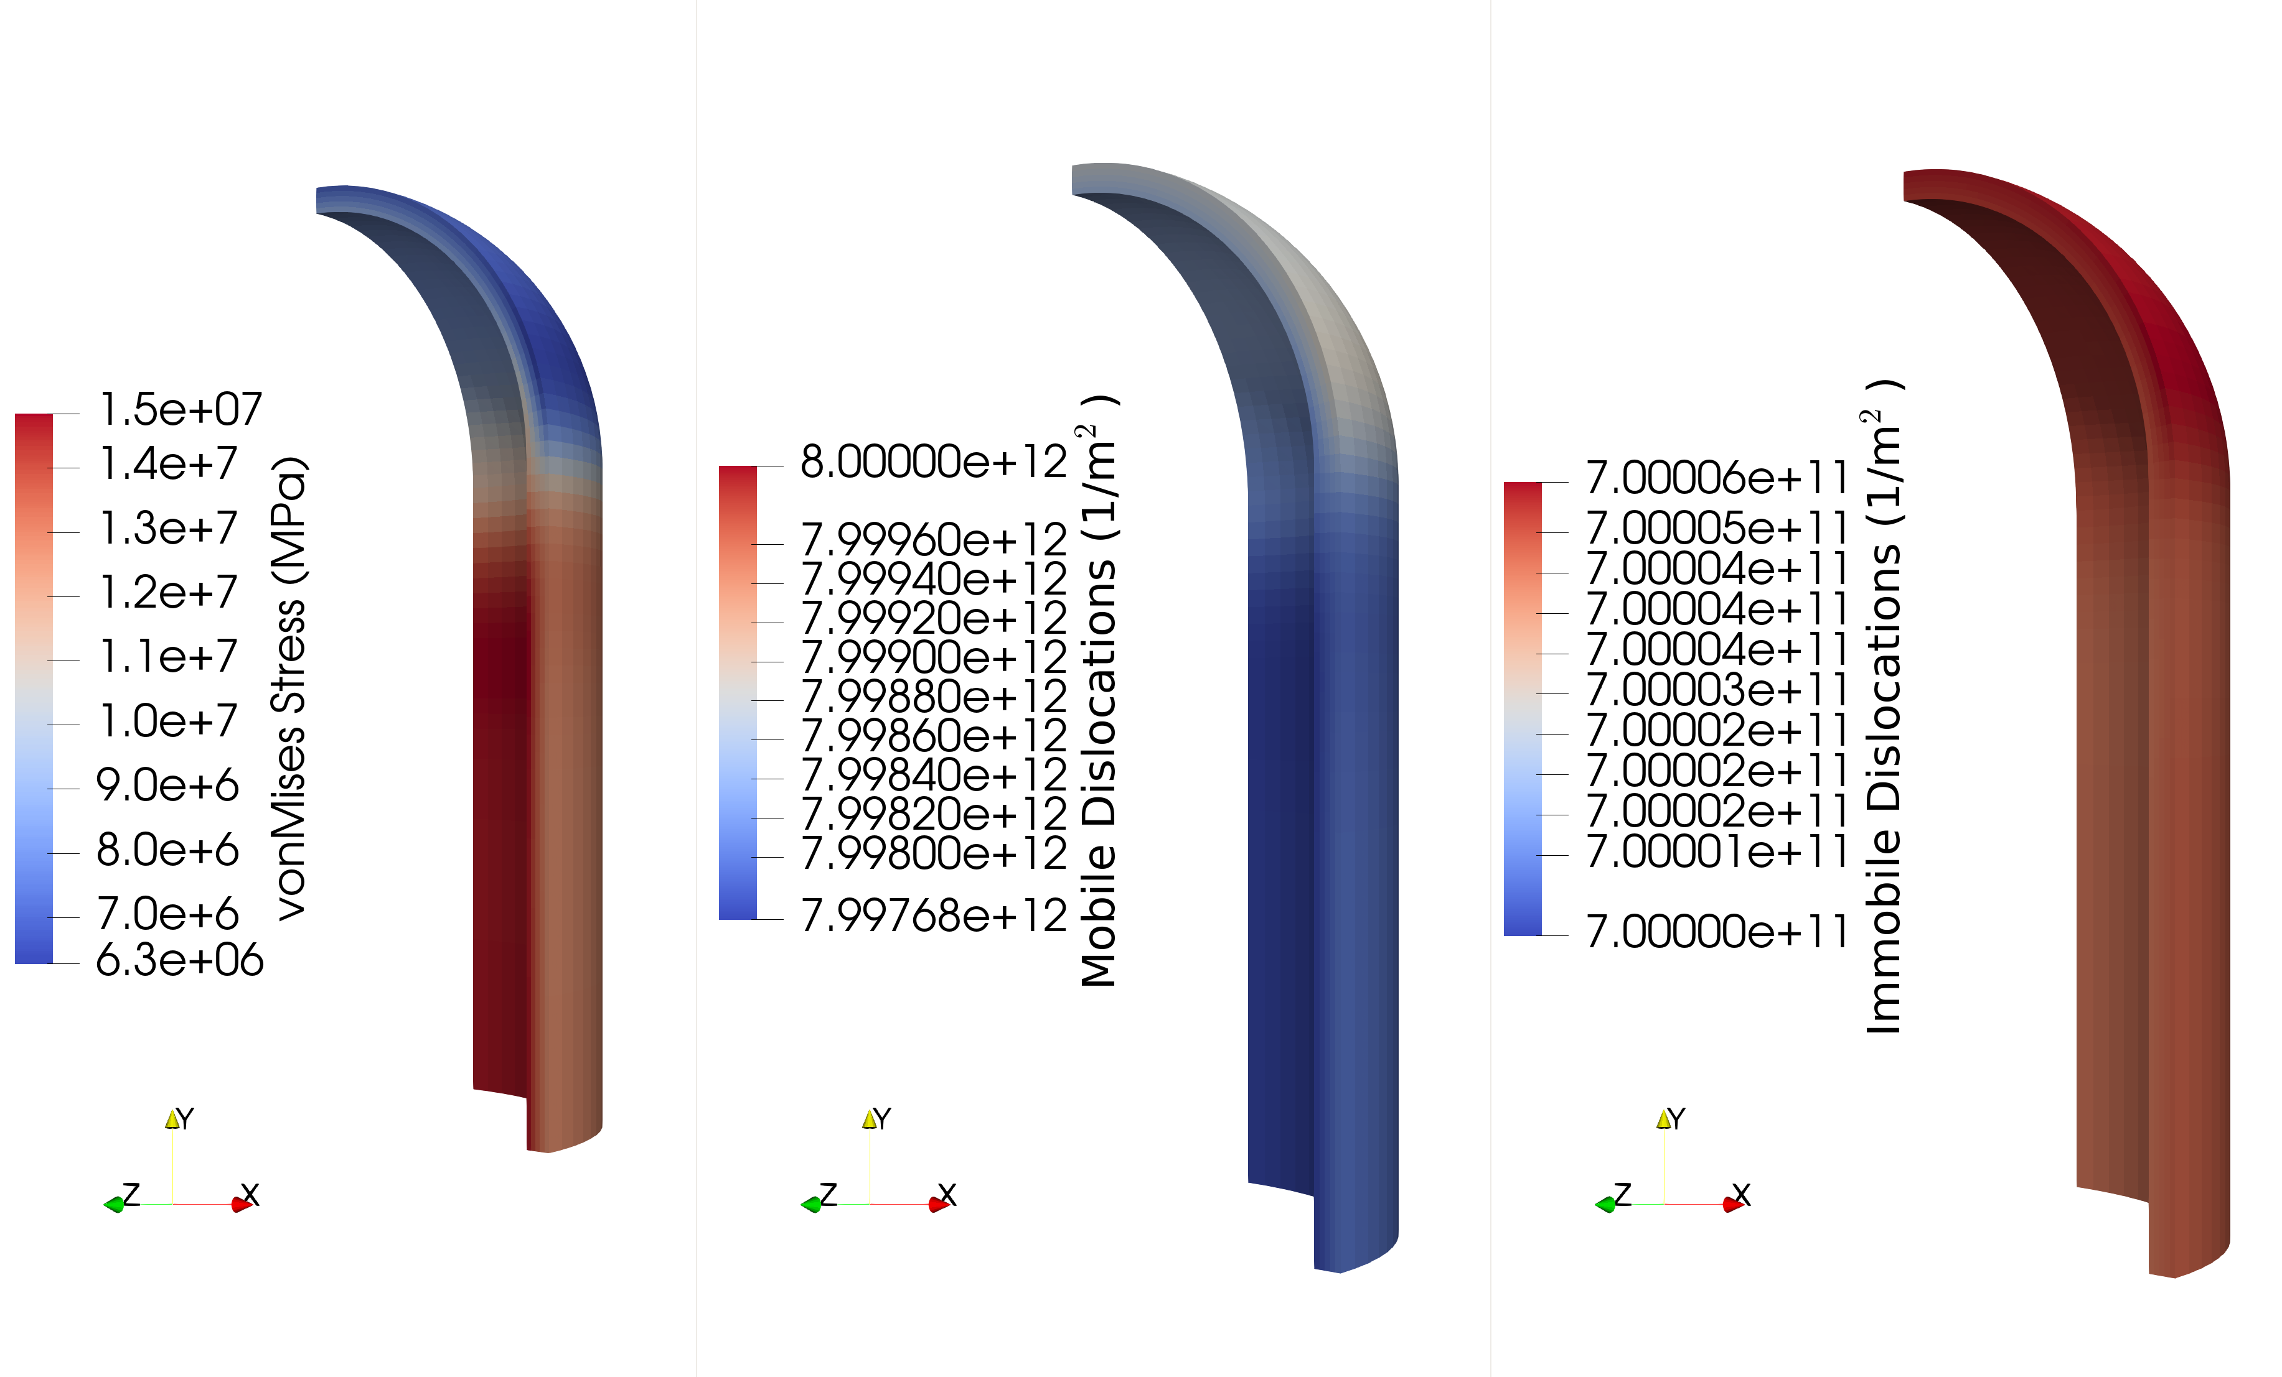
Constant Internal Pressure of 1.5MPa, held for 500s

Slide 11
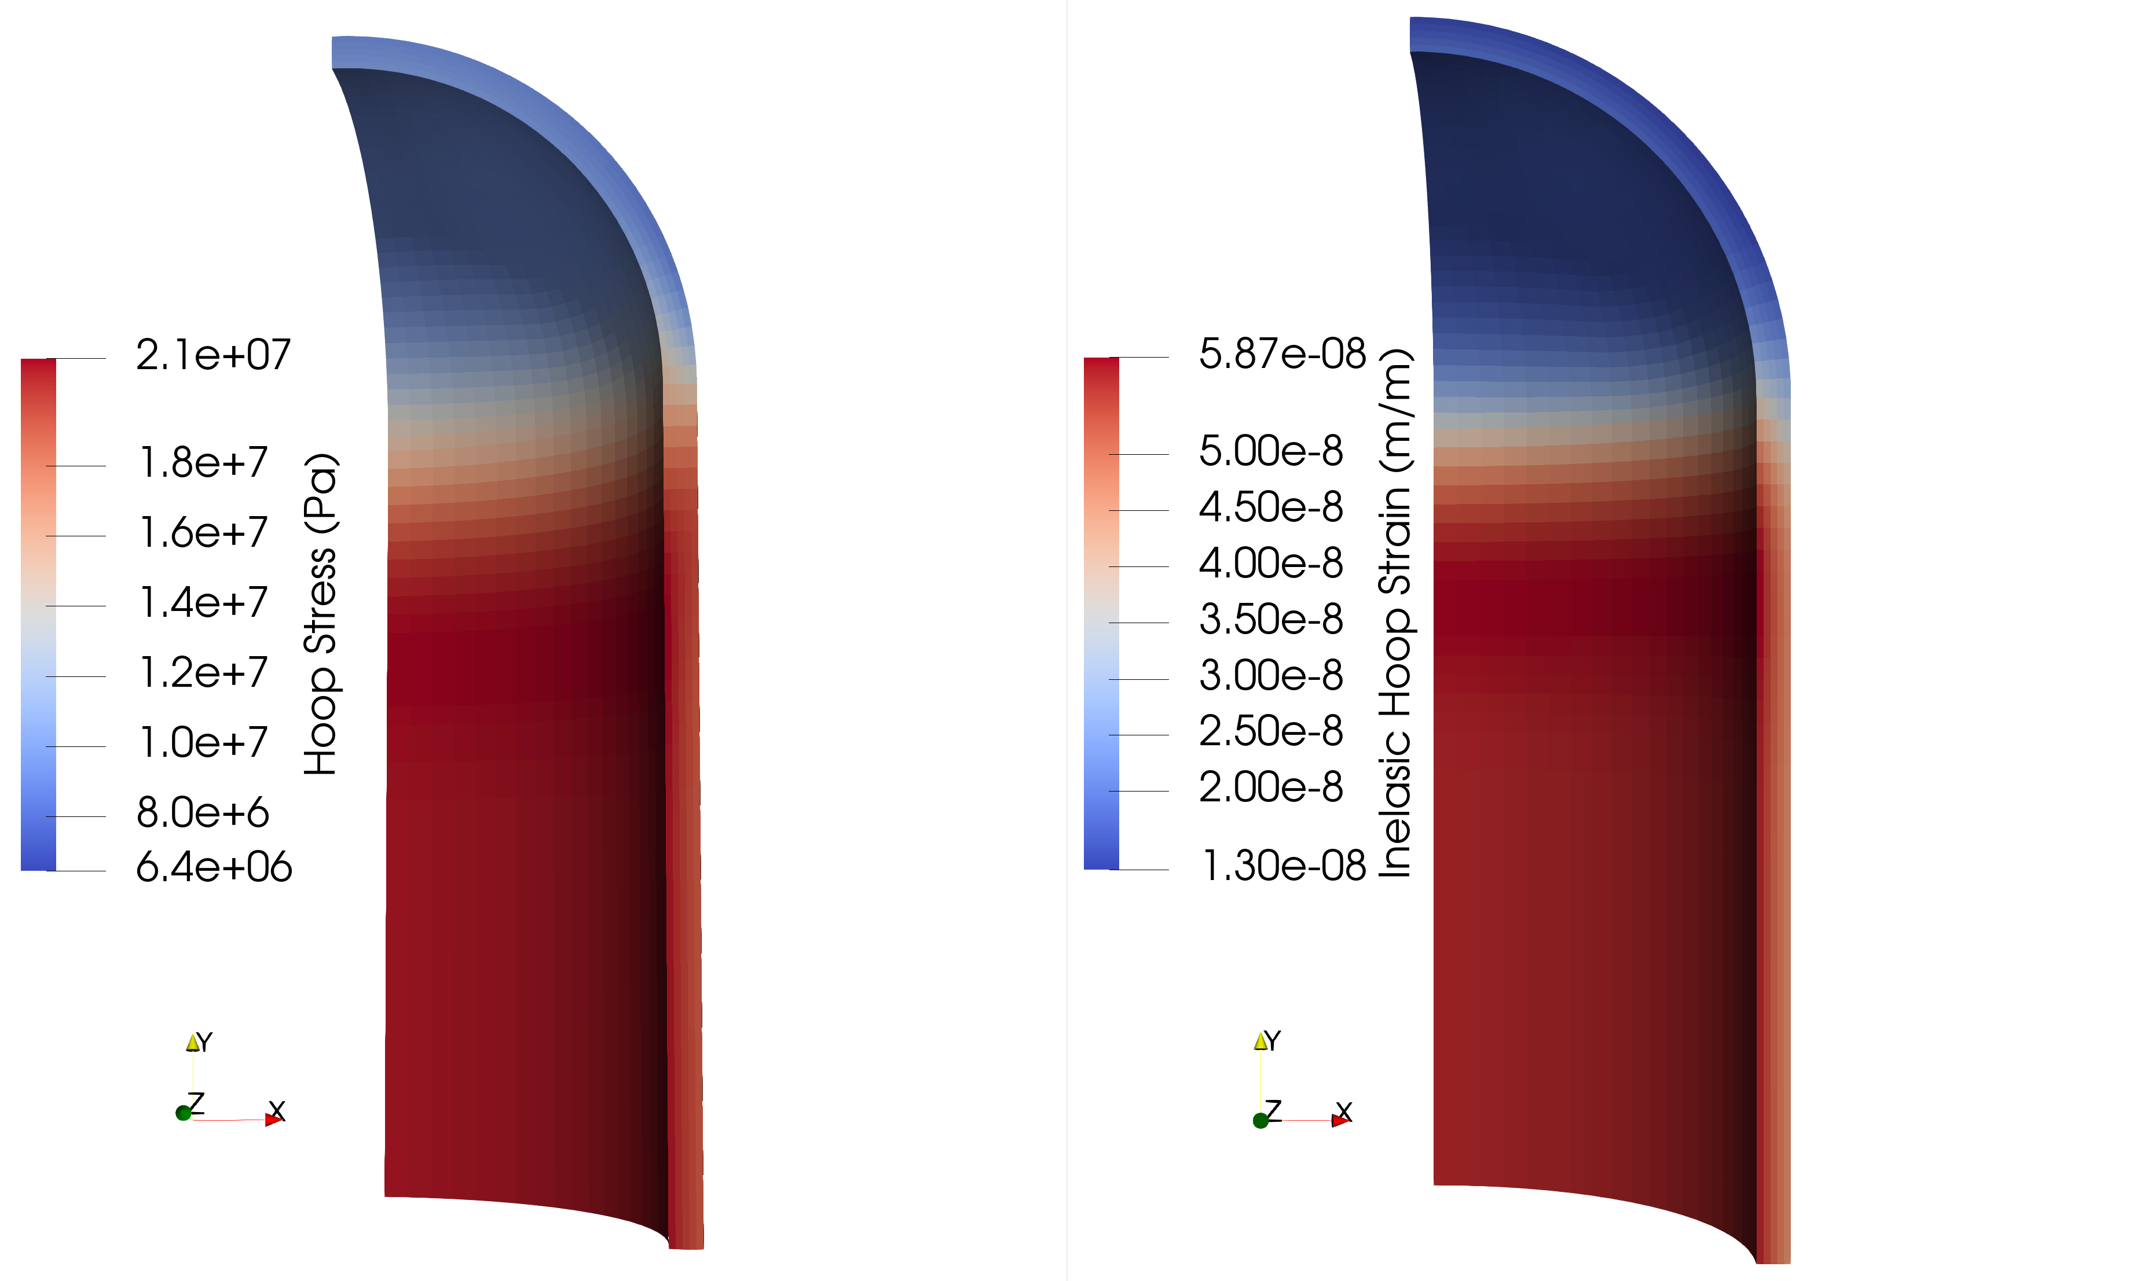
Constant Internal Pressure of 2.0MPa, held for 500s

Slide 12
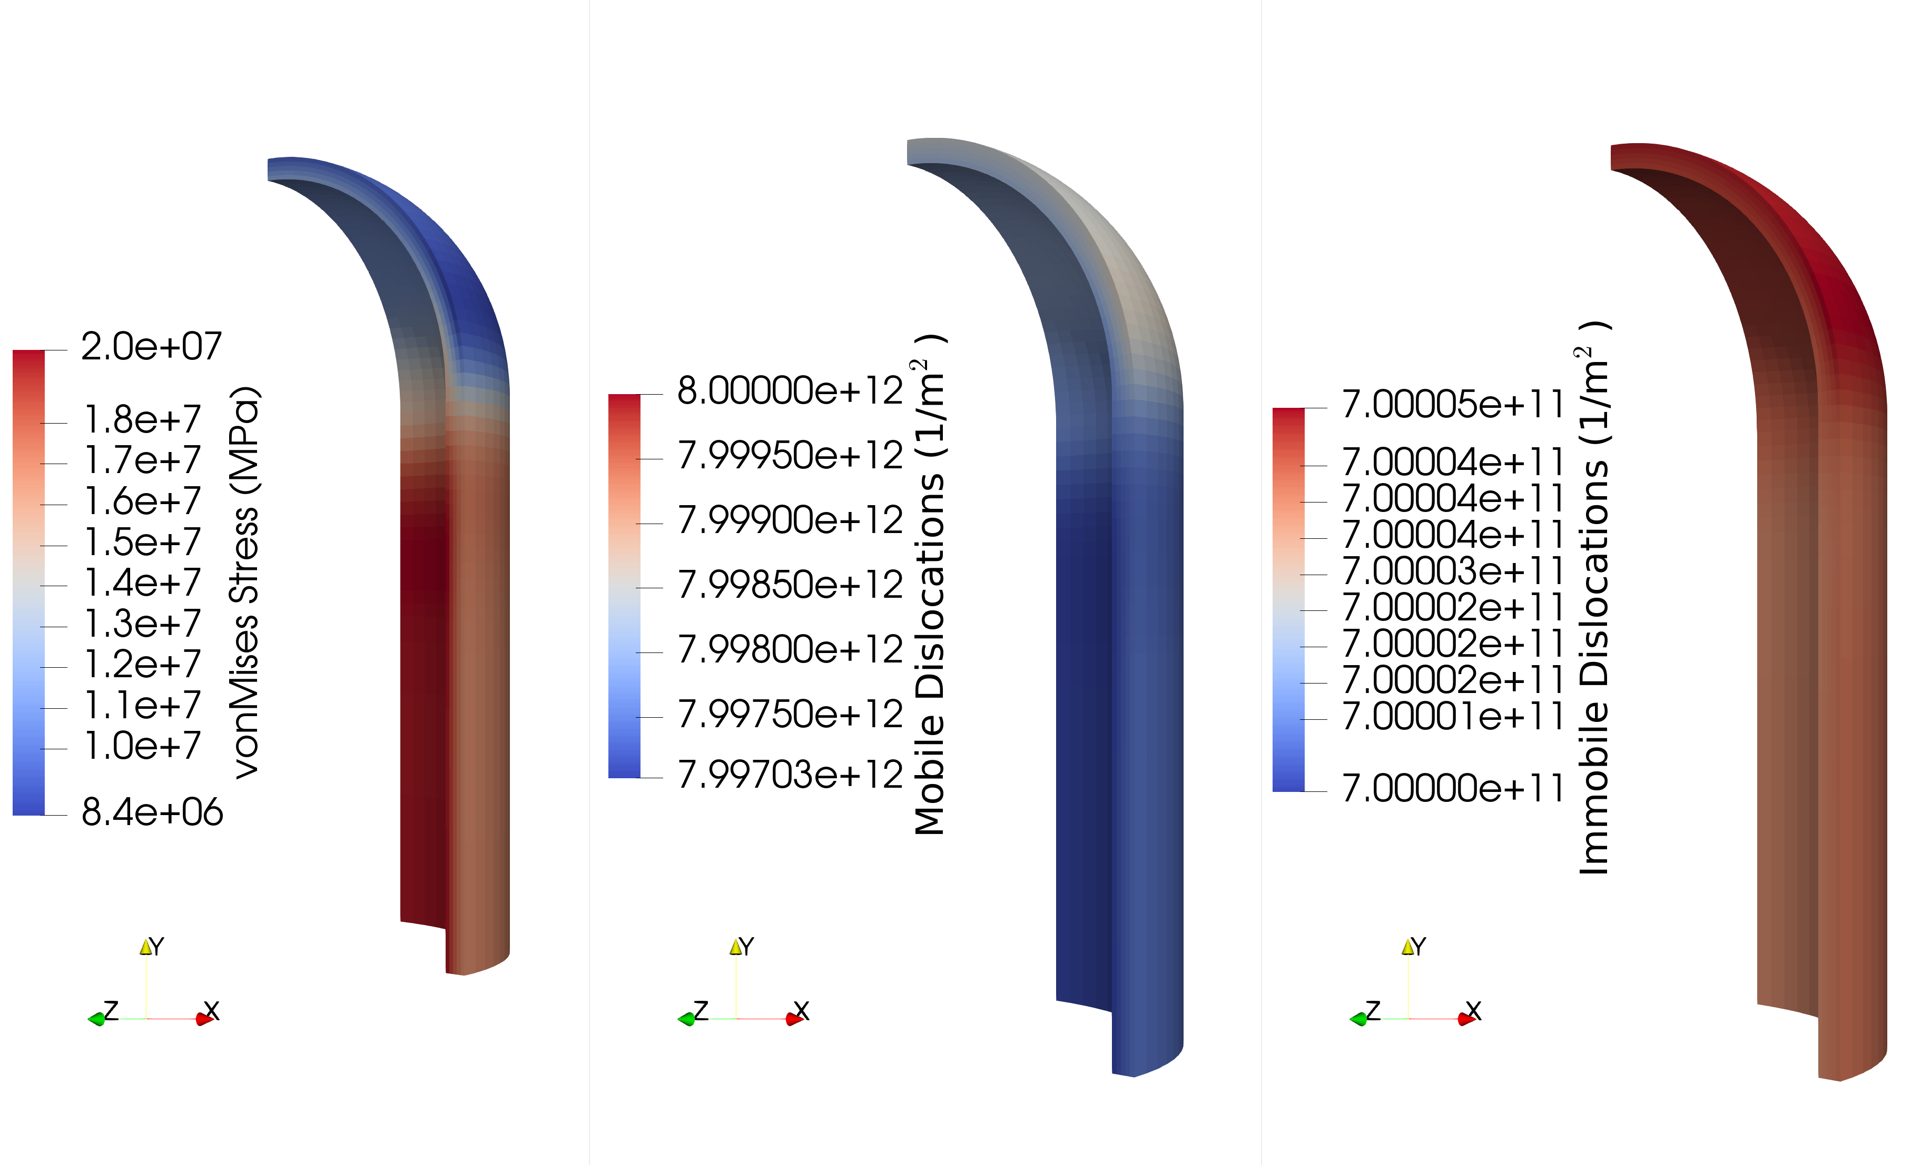
Constant Internal Pressure of 2.0MPa, held for 500s

Slide 13
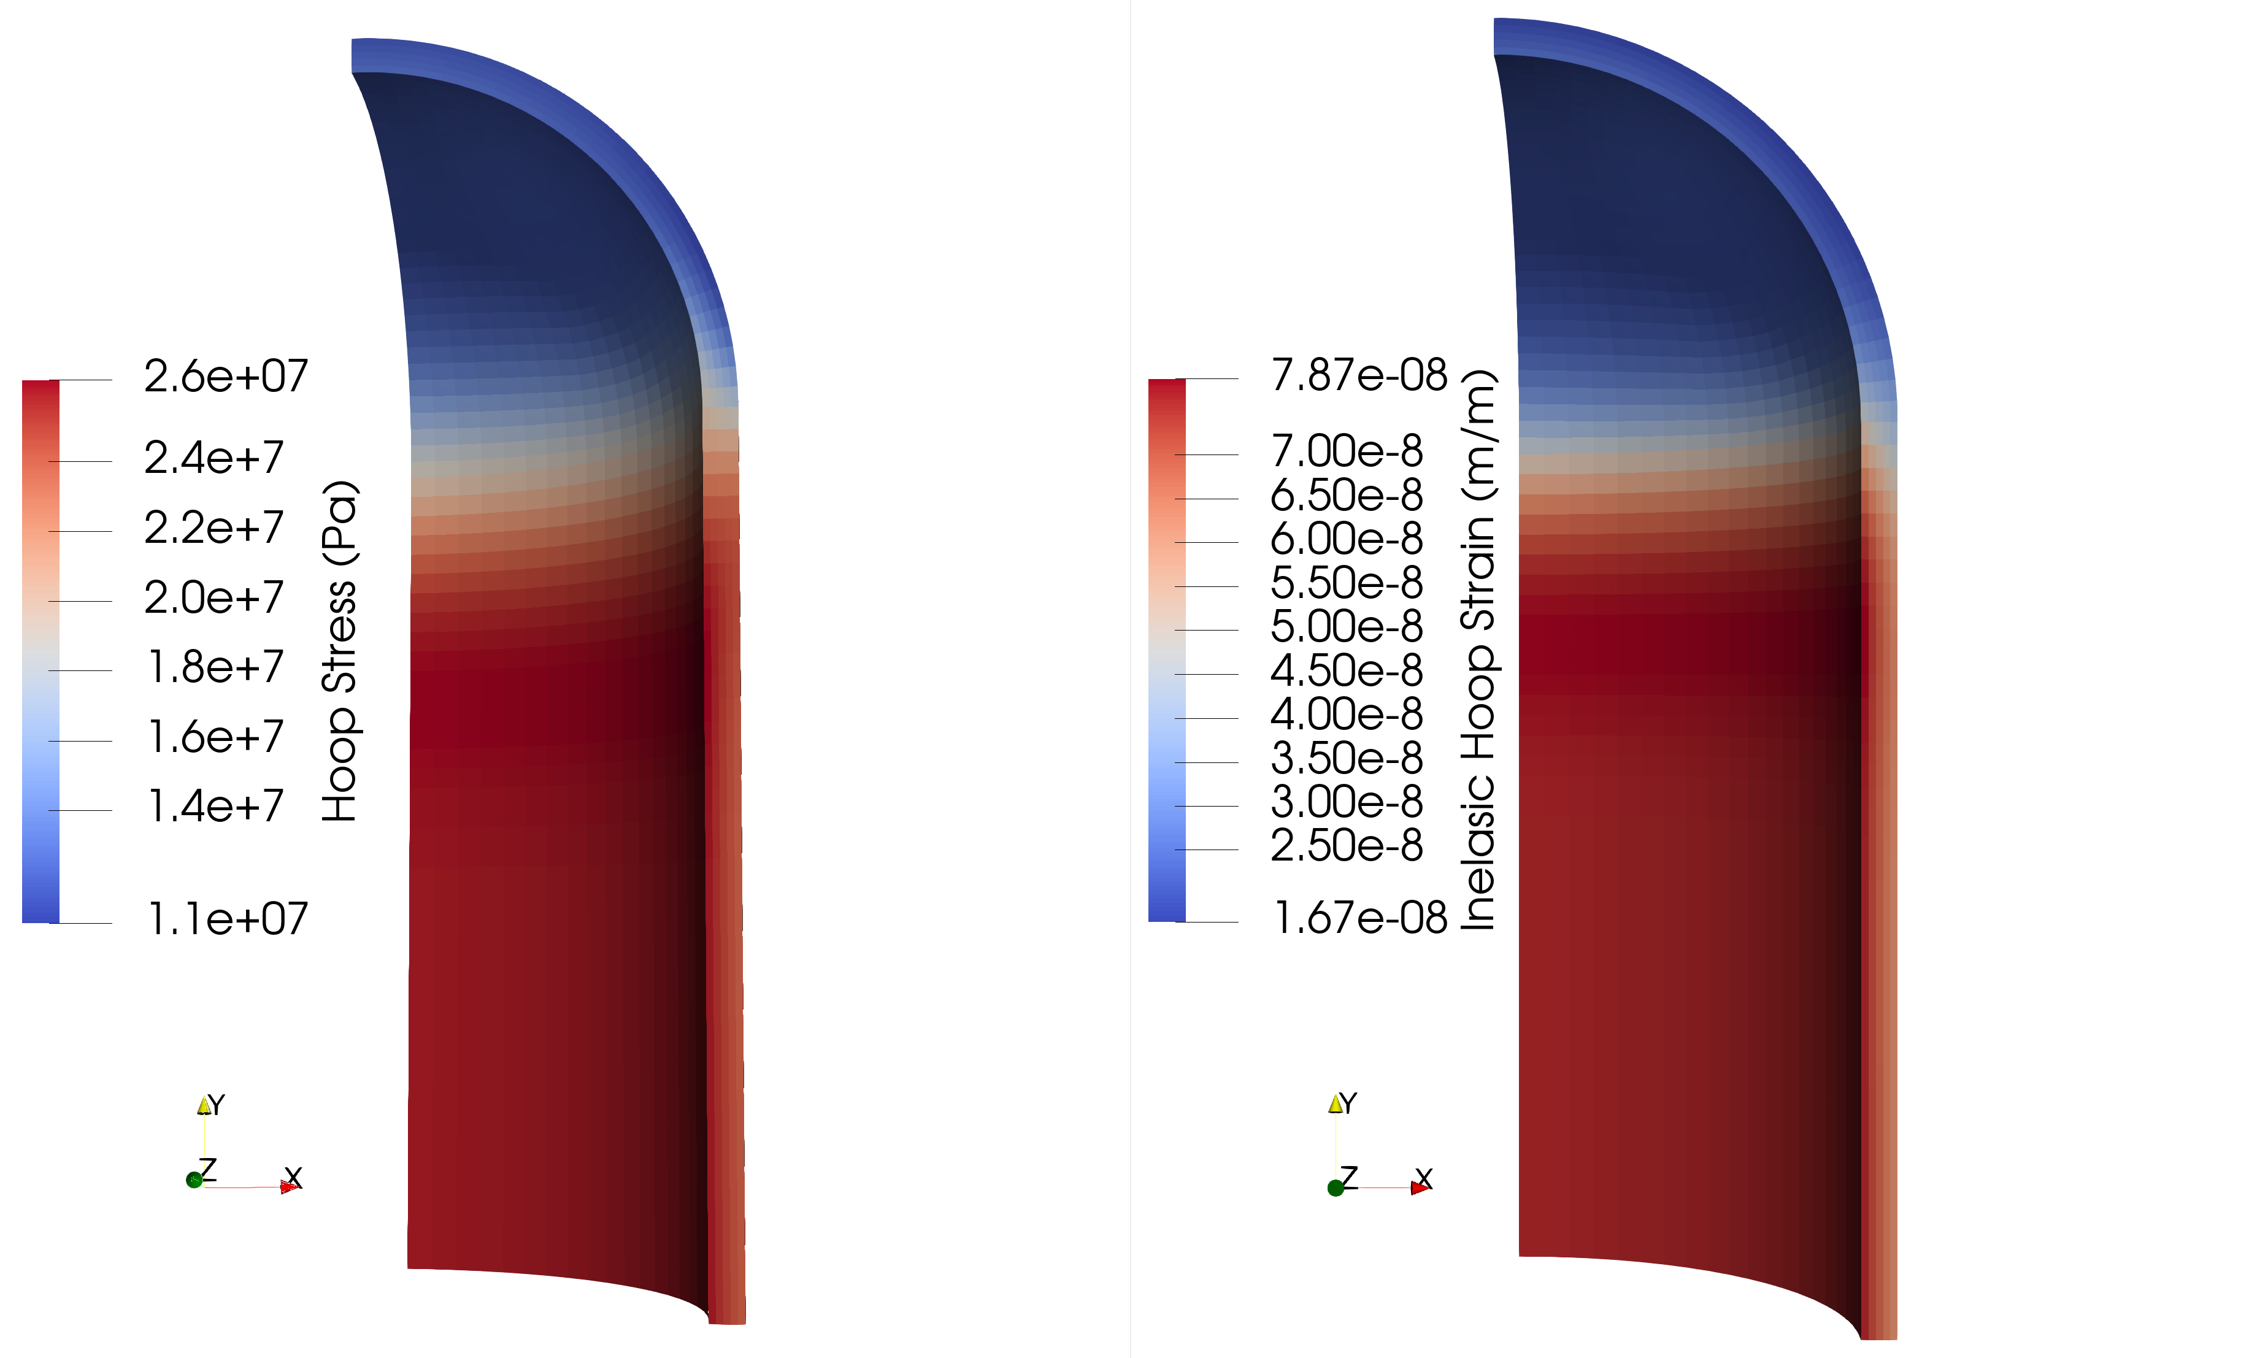
Constant Internal Pressure of 2.5MPa, held for 500s

Slide 14
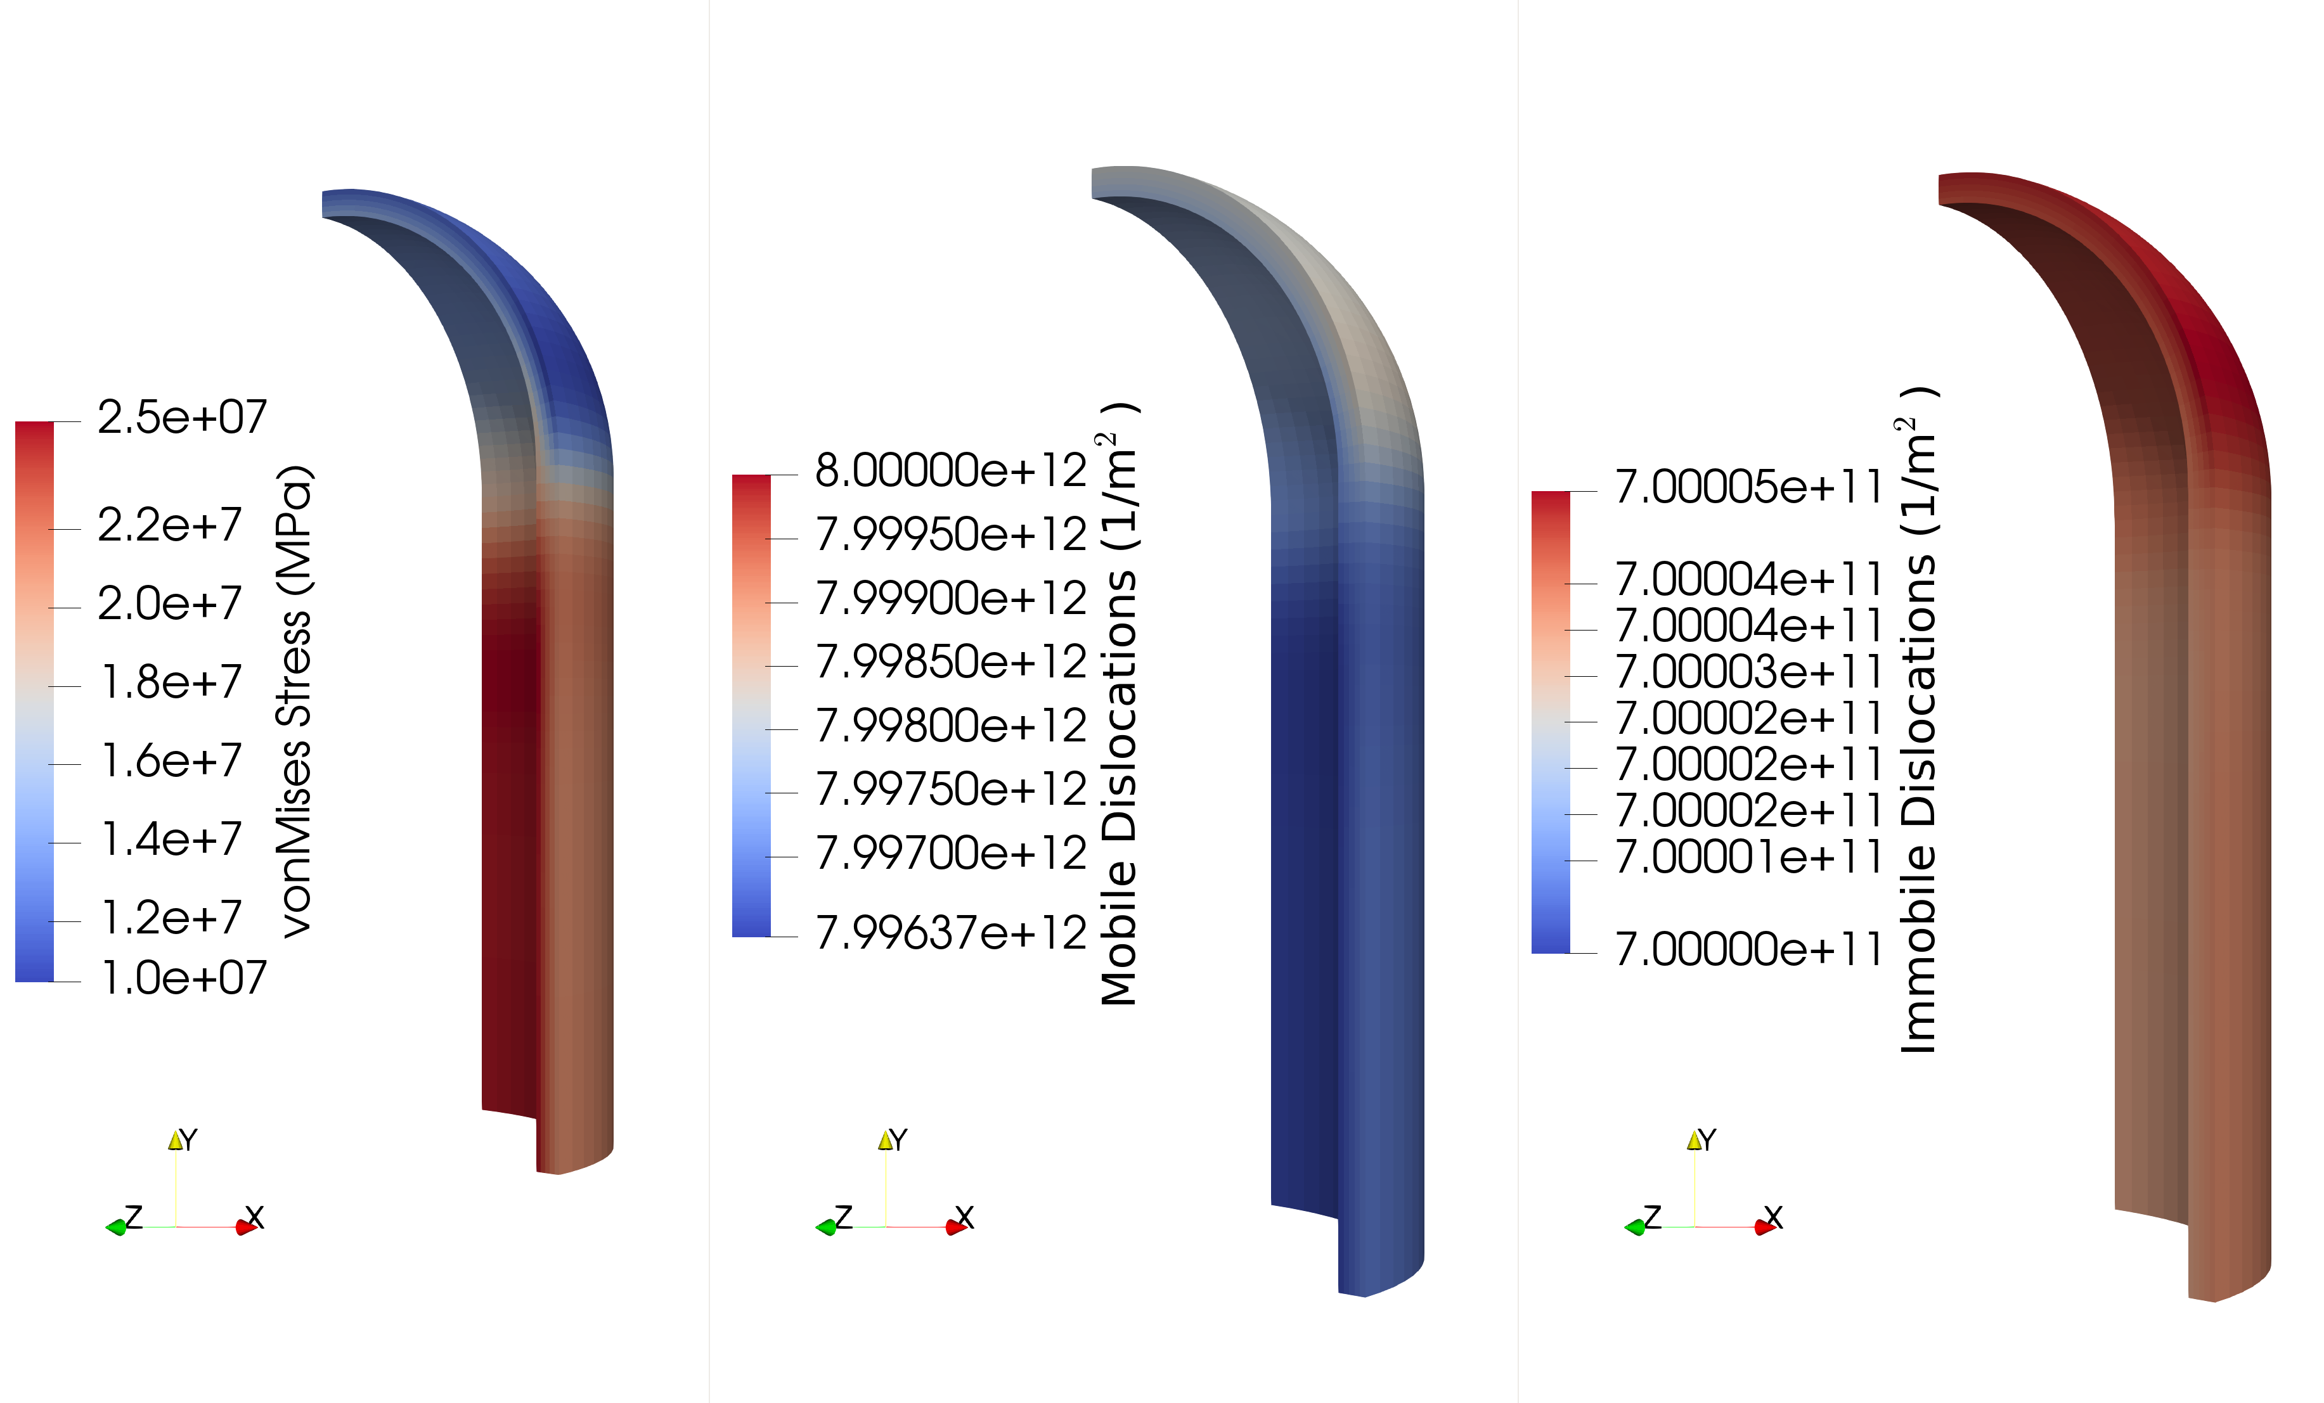
Constant Internal Pressure of 2.5MPa, held for 500s

Slide 15

Constant Internal Pressure of 3.0MPa, held for 500s

Slide 16
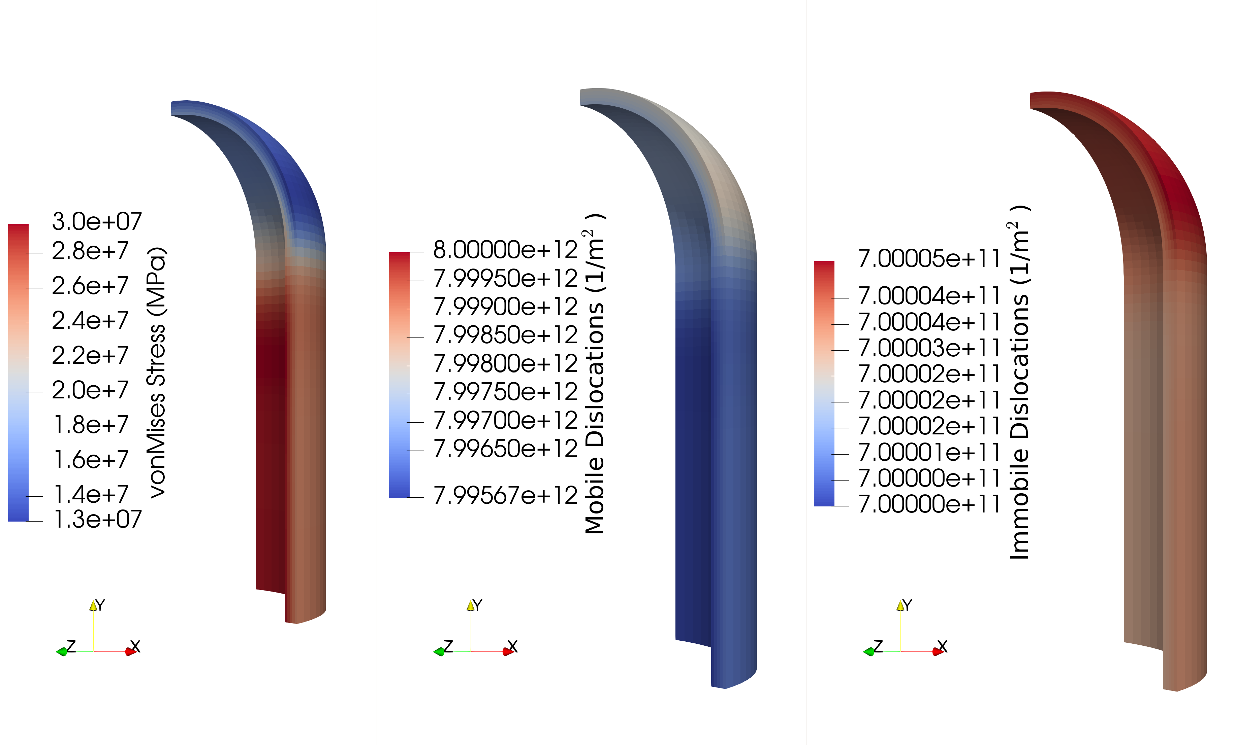
Constant Internal Pressure of 3.0MPa, held for 500s

Slide 17
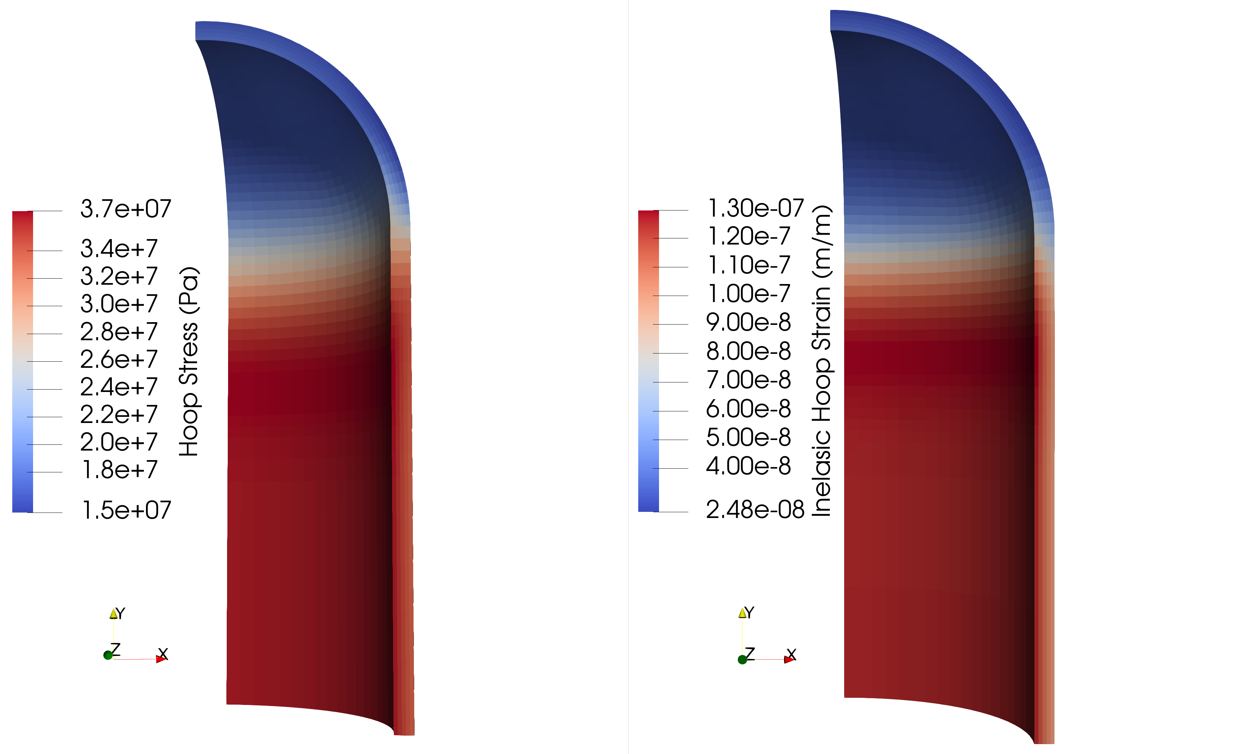
Constant Internal Pressure of 3.5MPa, held for 500s

Slide 18
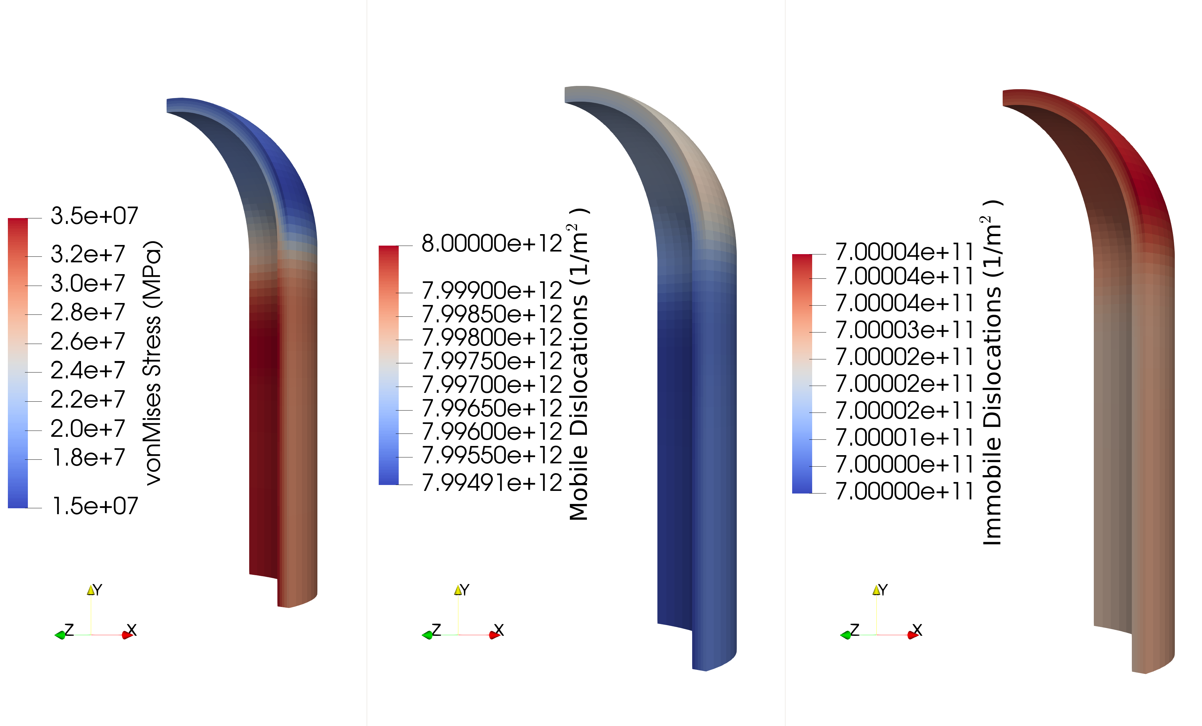
Constant Internal Pressure of 3.5MPa, held for 500s

Slide 19

Constant Internal Pressure of 4.0MPa, held for 500s

Slide 20

Constant Internal Pressure of 4.0MPa, held for 500s

Slide 21

Constant Internal Pressure of 4.5MPa, held for 500s

Slide 22
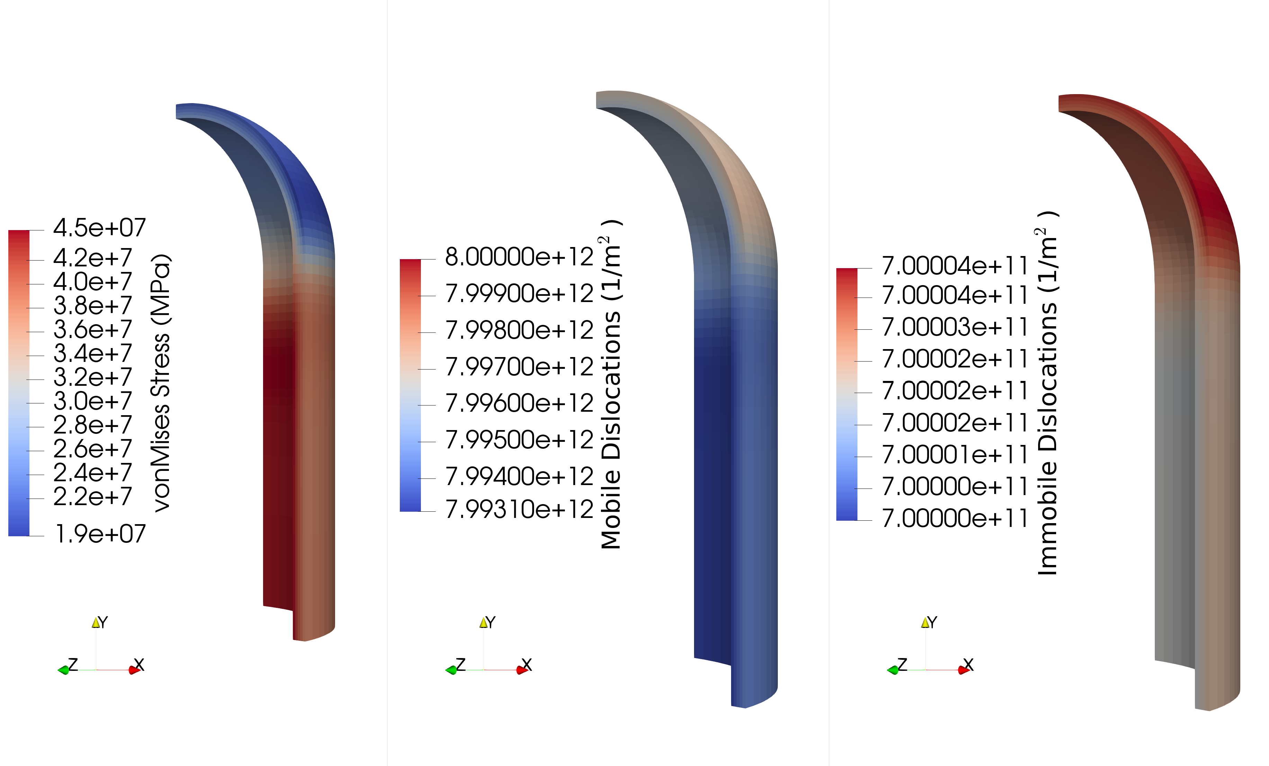
Constant Internal Pressure of 4.5MPa, held for 500s

Slide 23
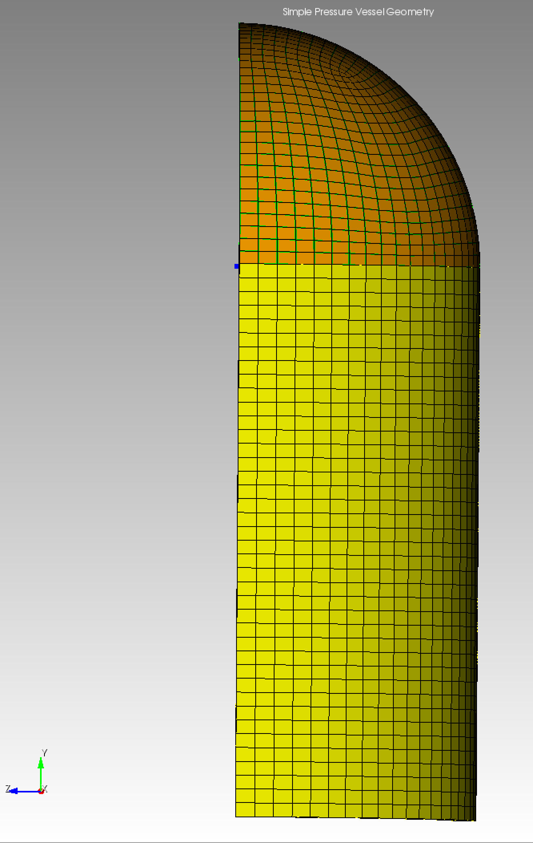
Uniaxial Tension and Pressure Cases
Varied the displacement rate
Applied along the y-axis
Uniform rate to entire end cap outer surface (shown on right in orange)
Internal pressure value of 1.0 MPa
Simulation length set to create a final displacement value of 6.5e-6
Corresponds roughly to a 0.01% strain at the mid point of the capsule cap
Results are shown for progressively lower displacement rate

Slide 24
General Observations: Uniaxial Tension Cases
Summation of the results shown in the next 10 slides (2 per case):
Consistent pattern and respective values of hoop stress (max 19 MPa) and von Mises stress (max 37 MPa) across all cases
Because the von Mises stress is much higher than the hoop stress, limited in ability to currently model desired hoop stress range
The evolution of the inelastic hoop strain and dislocation densities is strongly dependent on the displacement rate used
Hypothesize that the evolution differences is due more to the simulation length (input parameter for total time) than the applied displacement rate
Will run simulations with an applied displacement rate, followed by a hold period at constant pressure and displacement to test this hypothesis

Slide 25
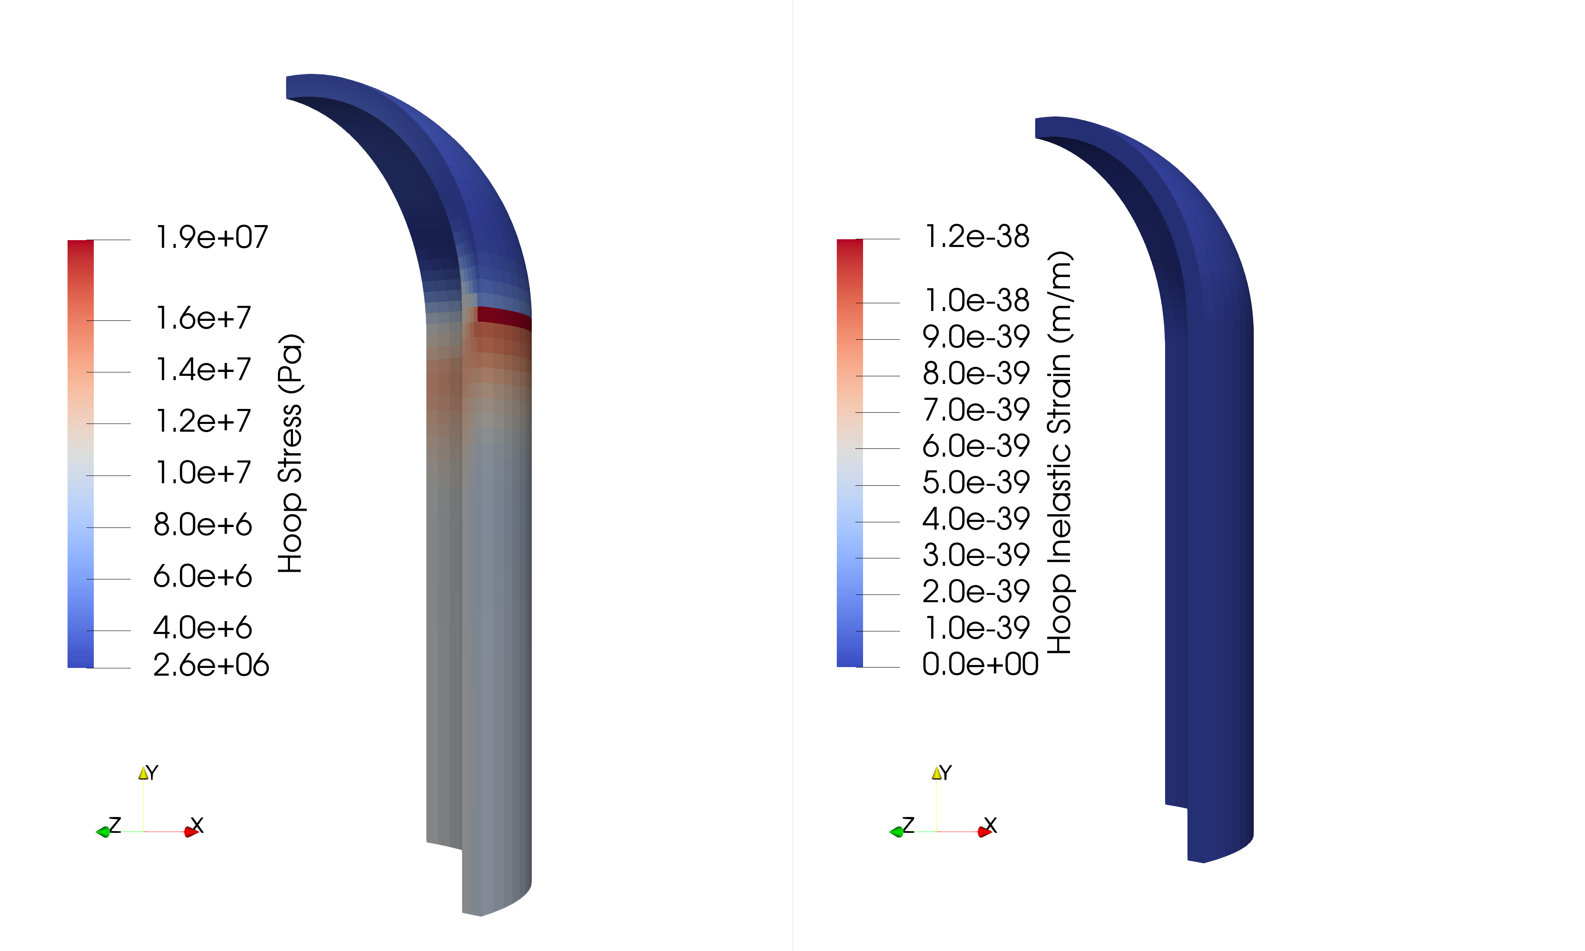
Displacement Rate 1.64e-5 m/s, 1MPa Pressure

Slide 26
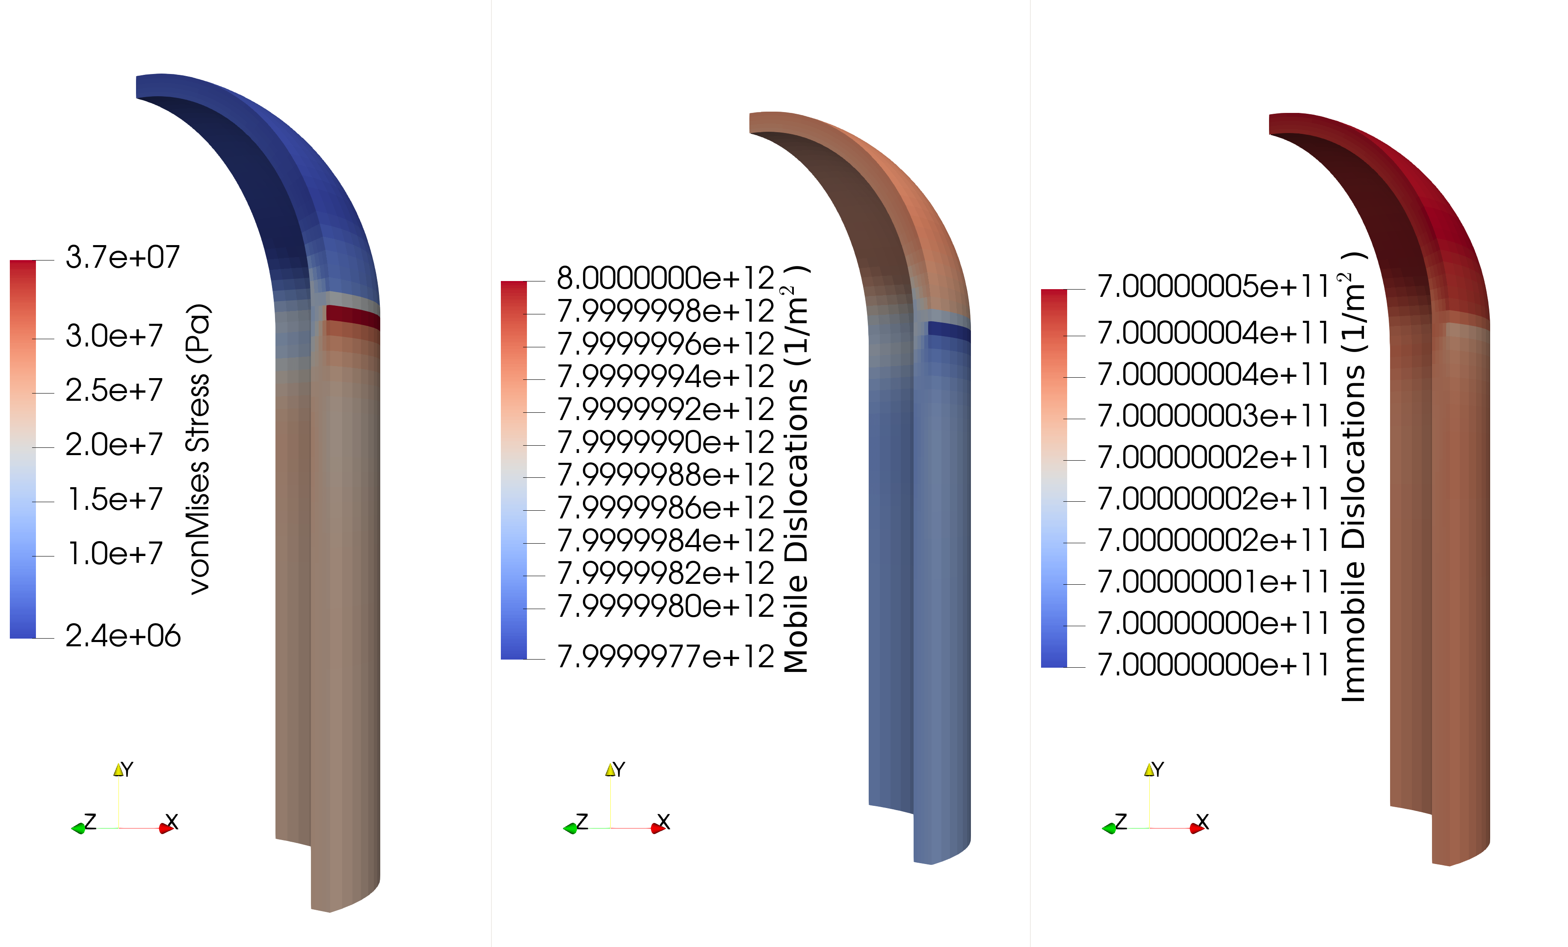
Displacement Rate 1.64e-5 m/s, 1MPa Pressure

Slide 27
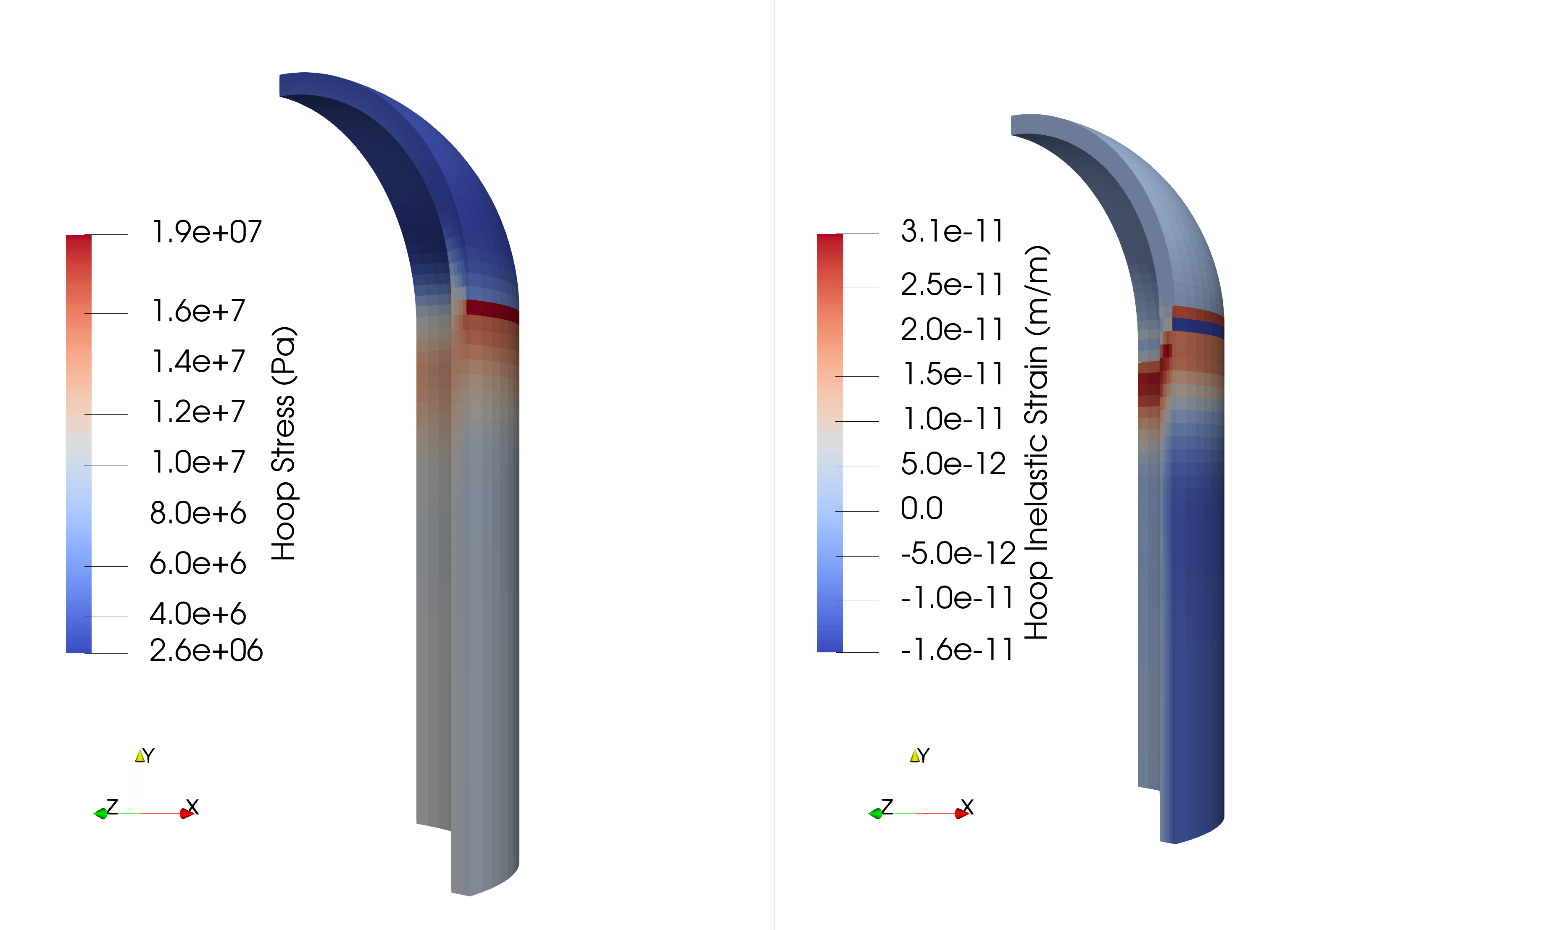
Displacement Rate 1.64e-6 m/s, 1MPa Pressure

Slide 28

Displacement Rate 1.64e-6 m/s, 1MPa Pressure

Slide 29
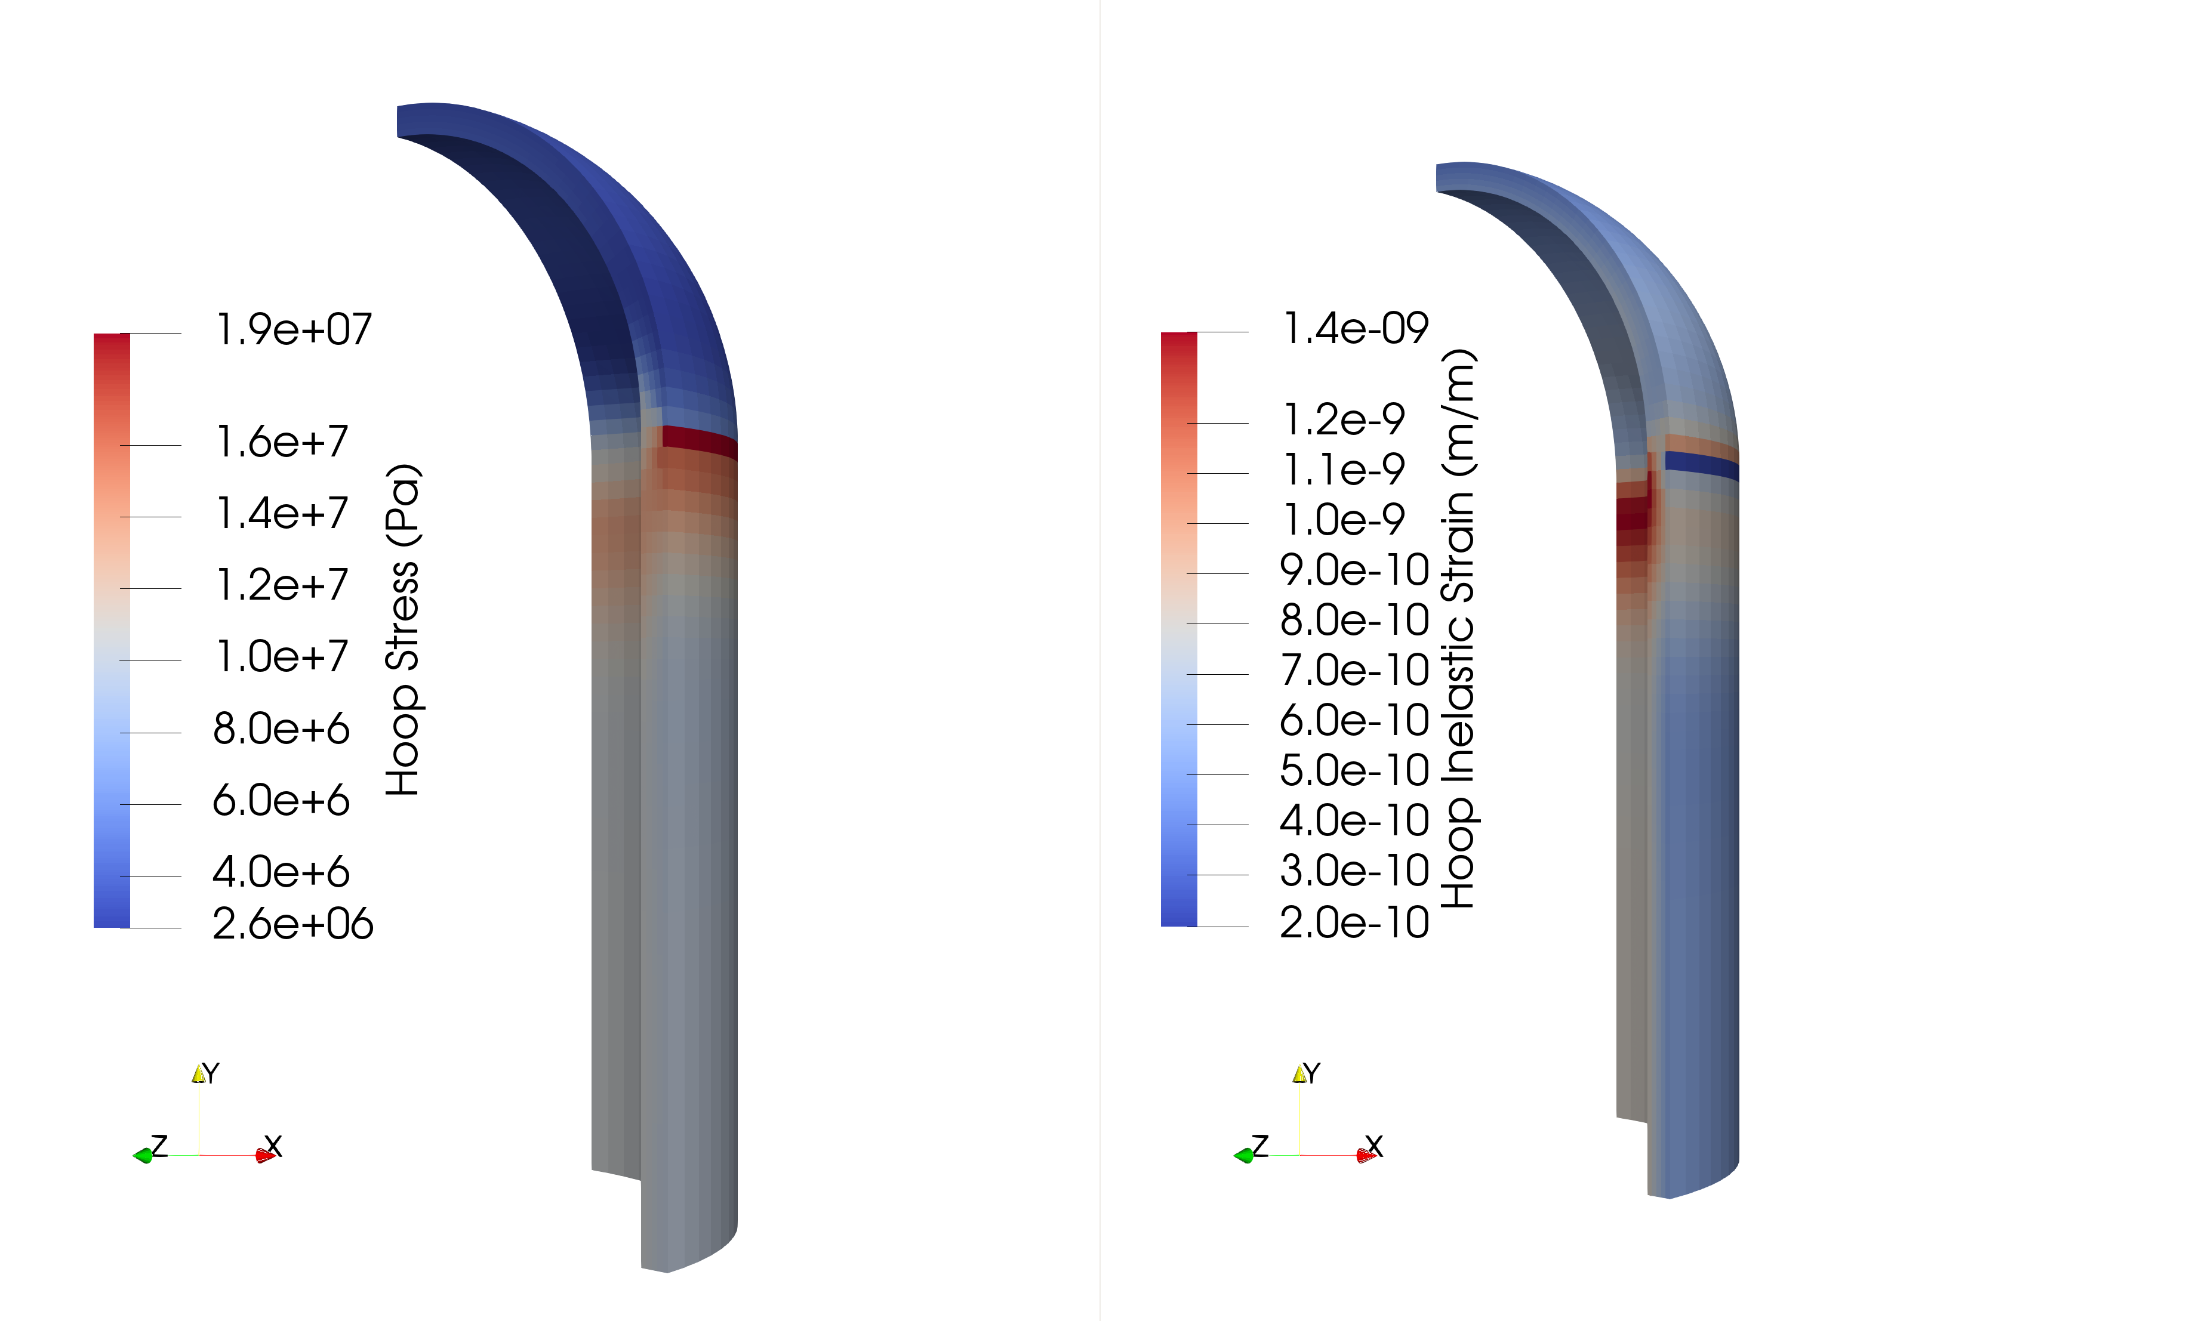
Displacement Rate 1.64e-7 m/s, 1MPa Pressure

Slide 30

Displacement Rate 1.64e-7 m/s, 1MPa Pressure

Slide 31
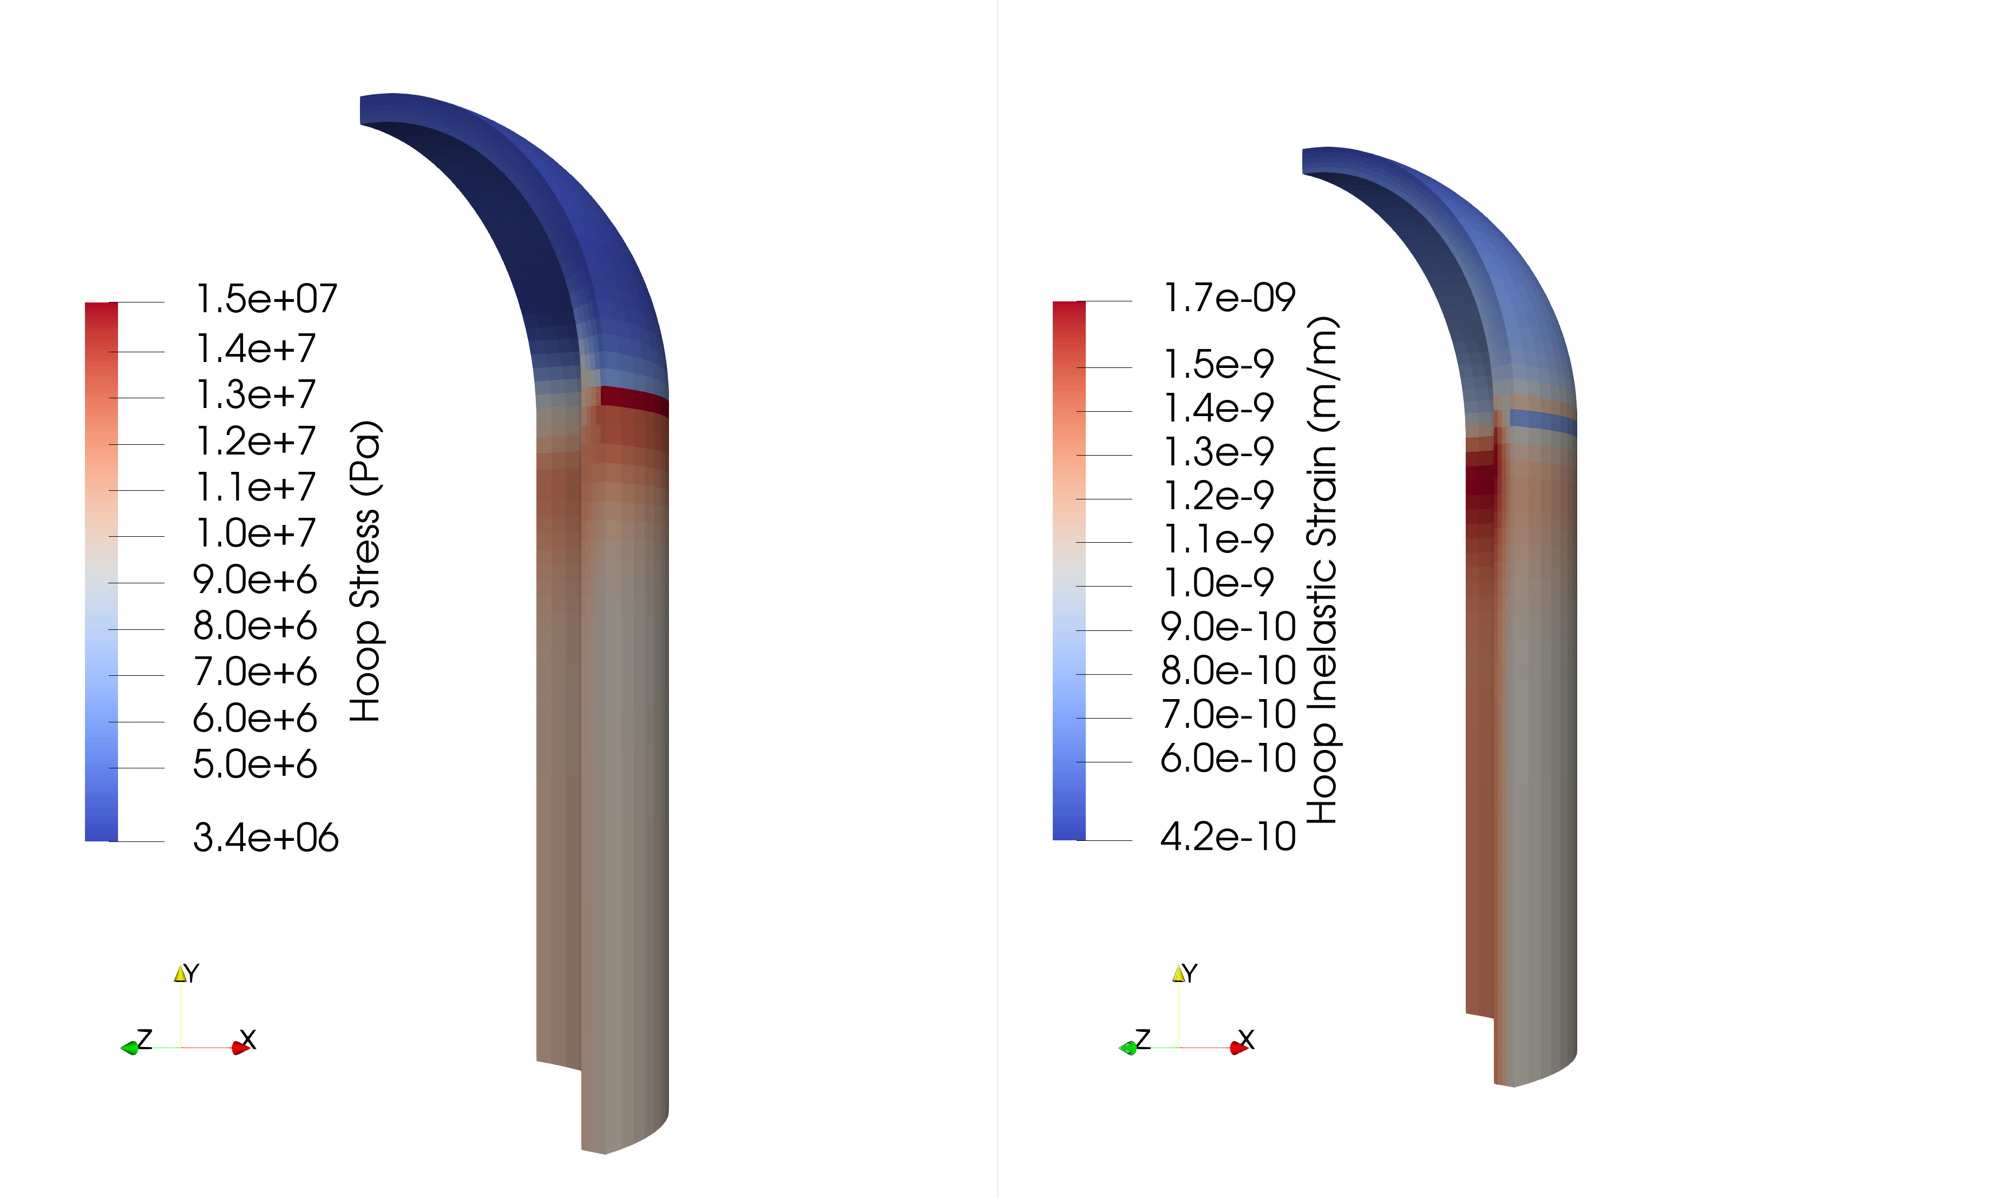
Displacement Rate 1.0e-7 m/s, 1MPa Pressure

Slide 32
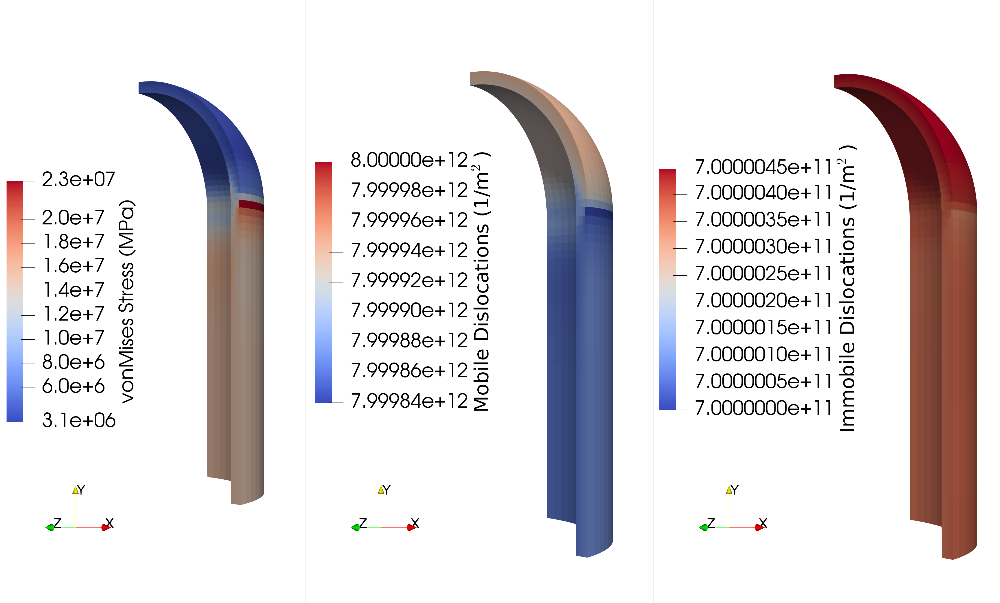
Displacement Rate 1.0e-7 m/s, 1MPa Pressure

Slide 33

Displacement Rate 1.64e-8 m/s, 1MPa Pressure

Slide 34
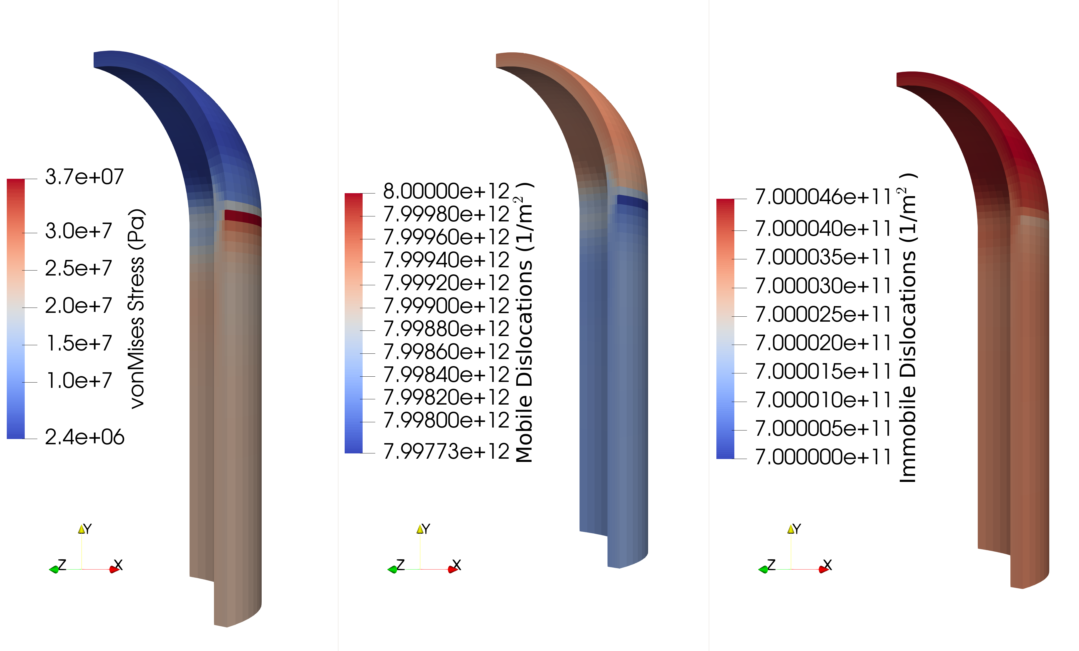
Displacement Rate 1.64e-8 m/s, 1MPa Pressure

